Slide 1

Server Side APIs - Part II
M3-D4
Participate! The more engagement the better! You are NEVER interrupting me!

Slide 2
Objectives
MVC Review
Dependency Injection
Validation
HTTP Response Codes
Error Handling
400 errors from Validation
Other errors like 404
Update / Delete
API Design Activity (time permitting)

Slide 3
NOTE: WHITEBOARD THE DIAGRAM

Slide 4
MVC (Model View Controller) Pattern
Model View Controller (MVC) is a pattern that divides the application based on responsibility.
Model
application state and business logic
only part of the application that talks to the database
Model could be classes
View
presents data to user
accept input from user
Views might be a desktop display, a mobile display, a file output based on a model
The View is not the output HTML/UI that displays in the browser or device, it is the code that generates the response.
Controller
Takes input from the view and passes it to the appropriate model objects
Grabs all necessary building blocks and organizes them for the output
Takes results from the model and passes it to the appropriate view
The end result is that the Model and View are unaware that the other exists. This decouples the Model and View.
The MVC Pattern is NOT only used for Web and Web Services. It is often used in other applications, and even exists in non-programming applications.

Slide 5
Dependency Injection
Inversion of Control (IoC) is a object oriented principle that inverts the flow of normal flow of control of an application from a class to a higher layer. It is commonly used in Java Frameworks.
Dependency Injection is a design pattern that implements IoC. It inverts control of the instantiation of dependencies from the class using them to an dependency injection container. Rather than instantiating classes with “new” in our class, they will be injected into our class at runtime.
Dependency Injection Container is code that creates and injects the dependencies into our class. Spring has a Dependency Injection Container built into it.

Slide 6
Dependency Injection in Spring Boot (Option 1)
Create an Interface with an Implementation class (CityDao)
Add the @Component annotation to the implementation class (JdbcCityDao)
Declare an argument of a constructor using the Interface
public CityController( CityDao cityDao)

Slide 7
Option 1 - Constructor Injection
@RestController
public class CityController {
private CityDao cityDAO;
public CityController(CityDao cityDAO) {
this.cityDAO = cityDAO;
}
@RequestMapping(path = "/cities", method = RequestMethod.GET)
public List<City> list() {
return cityDAO.list();
}
}
Implementation instance is injected (IF @component is found in the JDBC implementation class for this interface)

Slide 8
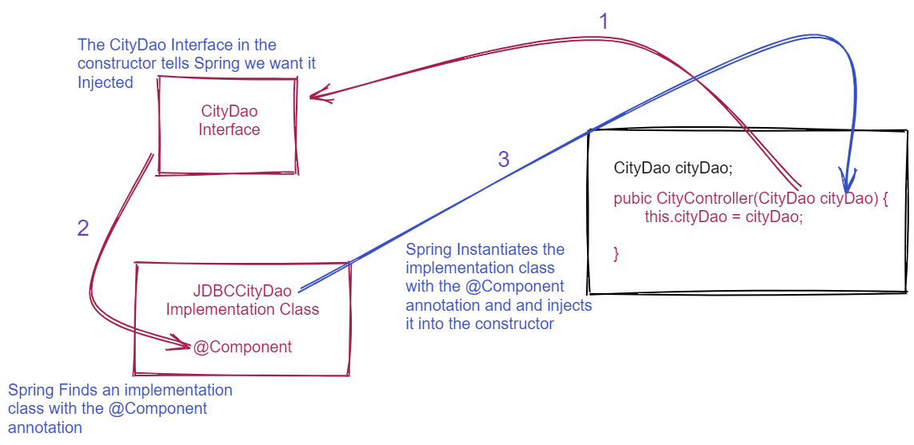

Slide 9
Option 2 - Autowire Injection
@RestController
public class CityController {
@Autowired private CityDao cityDao;
@RequestMapping(path = "/cities", method = RequestMethod.GET)
public List<City> list() {
return cityDAO.list();
}
}
Implementation instance is injected

Slide 10
RESTful Service Design - End Points
Define the endpoints
Endpoints should be plural names that define what is being accessed
Hotels, Reservations, Cities, etc.
IDs should be sent as Path Variables
Filters and Sorting should be sent as Query Parameters
/hotels /hotels/{id}/reservations
/hotels/sort?state=Ohio&city=Columbus /)

Slide 11
RESTful Service Design - CRUD
Define the CRUD
What do you want your user to be able to Create? (POST)
What do you want your user to be able to Read? (GET)
What do you want your user to be able to Update? (PUT)
What do you want your user to be able to Delete? (DELETE)
Not all CRUD needs to be included, only what you want the user to be able to access. Some CRUD operations may have multiple routes that do different things:
/hotels /hotels/{id} /hotels/filter?state=Ohio&city=Columbus /)

Slide 12
Validation
Add Constraint Annotations to the Data Class member variables
@Min( value = 1, message = "The field 'hotelID' is required.")
private int hotelID;
@NotBlank( message = "The field 'fullName' is required.")
private String fullName;
@NotBlank( message = "The field 'checkinDate' is required.")
private String checkinDate;
@NotBlank( message = "The field 'checkoutDate' is required.")
private String checkoutDate;
@Min( value = 1, message = "The minimum number of guests is 1")
@Max( value = 5, message = "The maximum number of guests is 5")
private int guests;
Add @Valid Annotation to the Controller Method receiving the object.
public Reservation addReservation(@Valid @RequestBody Reservation reservation
List of Constraints

Slide 13
HTTP Response Status Codes
2xx Status Codes can be applied to a controller method using the @ResponseStatus annotation
@ResponseStatus(HttpStatus.CREATED)
4xx Status Codes can be returned by throwing an Exceptions from the the Controller Method
@ResponseStatus( code = HttpStatus.NOT_FOUND, reason = "Hotel not found.") public class HotelNotFoundException extends Exception
public Reservation addReservation(@Valid @RequestBody Reservation reservation, @PathVariable("id") int hotelID throws HotelNotFoundException

